Slide 1
Customer churn prediction -Amrutha tallam
Problem statement :
To build a predictive model to estimate the likelihood of customer churn for a telecom company .
Considering factors such as customer demographics, usage patterns ,billing history, and customer service interaction .
Dataset used:
https://www.kaggle.com/datasets/blastchar/telco-customer-churn
Model selected: machine learning classification model

Slide 2
Predicting customer churn is of paramount importance for telecom companies due to several reasons:
Revenue Retention
Customer Satisfaction
Market Competition
Brand Reputation
Data-Driven Decision Making
Long-Term Profitability

Slide 3
Insights gained from exploratory data analysis (EDA) and model building .
The size of the data set is 7043 rows and 21 columns.
The output column is a categorical value so i selected classification (output variable = churn )
There are no duplicate values, null values and outliers in the data .
In feature engine I have used label encoding to convert categorical columns to numerical columns.
I have used min max scalar to scale the data.
Next I have split the data into train and test
To check the accuracy of the models I used the following classifiers :
Logistic regression, decision tree classifier, random forest classifier, svc, xgb, adaboost
Did cross validation.
Serialized the model and saved it
Model was best fit in xgb classifier with training accuracy 99 percent and testing accuracy 76

Slide 4
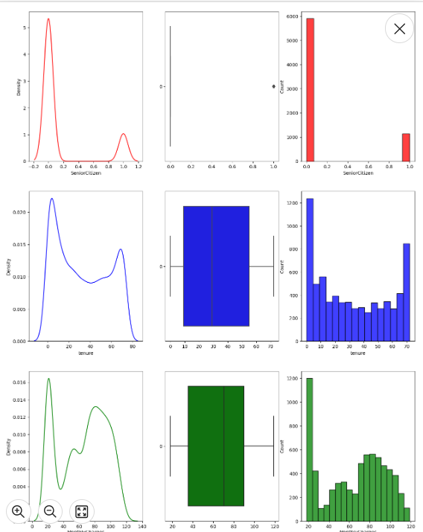
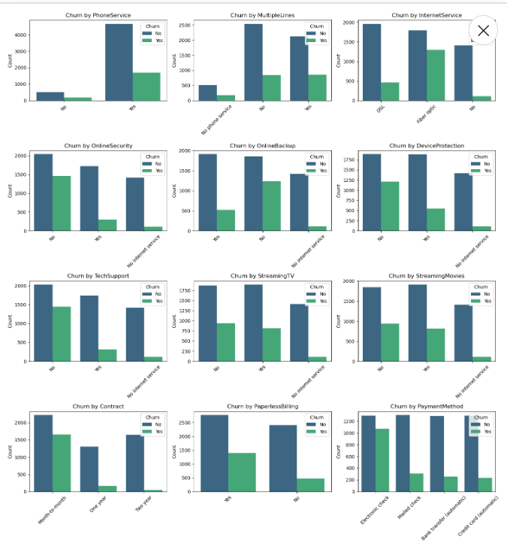
These are few data visualizations based on the output variable (churn)

